Slide 1
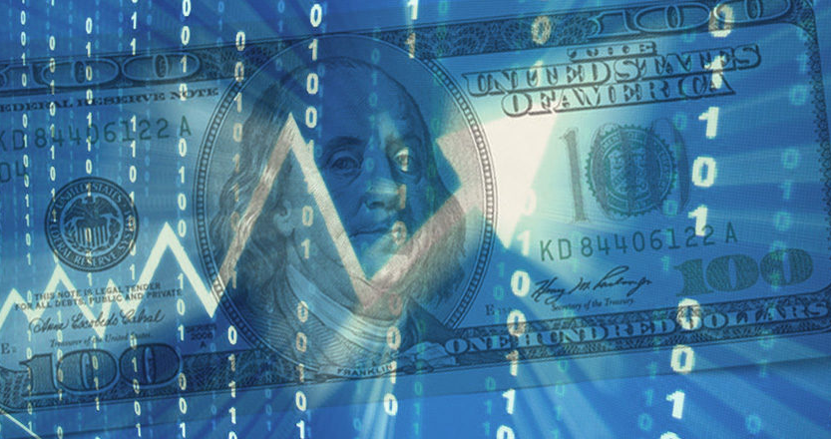
Machine Learning Aided Stock Prediction and Analysis
VinothKumar Kolluru 10457948
Ava Engstrom 10434763
Baby Valikala 10453125

Slide 2
Agenda
Introduction
Why this project ?
Goals
Data Plots
Machine Learning Algorithms
Conclusion
Areas of Improvement

Slide 3
Why this Project?
Stocks have a large impact on many aspects of life
As of 2015, 48% of Americans invested in the Stock Market
Stock Market is “risky”
Aid in decision making
Notes:
The stock market is a very important facet of the world that we live in. Stock market trends impact people’s livelihoods whether they work directly with stocks or not. Along with that, many people invest directly in the stock market, and so would be interested in being able to predict stock
There are also many who are hesitant to invest due to the risk associated, and perceived inability to mitigate said risk. The stock market is difficult to predict and so people are nervous about investing. Being able to predict the stock market with some accuracy would give comfort to such people
** in general, need to add images to slides

Slide 4

Tesla Inc. Chief Executive Officer Elon Musk has added $10.4 billion to his fortune this year
Amazon founder and CEO Jeff Bezos, is $13.9 billion richer this week, giving him a net worth of $193.4 billion, Forbes calculates
How does Money makes Money ?

Slide 5
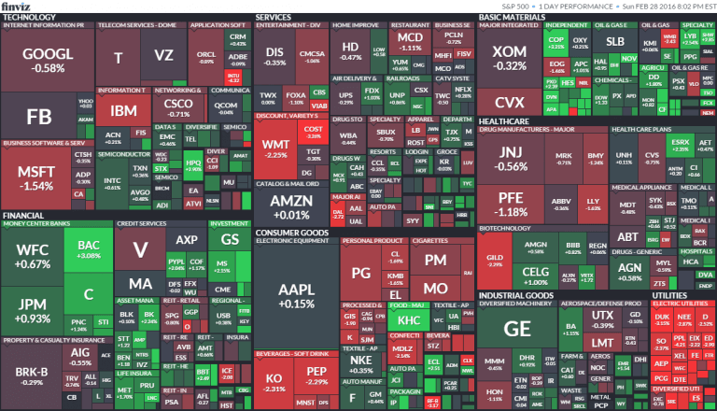
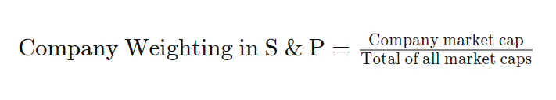
S&P 500 Index
Market Capitalization weighted Index
Gauge of US equities
Tracked by many funds
Good representation of US Stock Market Performance
Notes:
Also known as the Standard & Poor’s Index, the S&P 500 is a market capitalization weighted index using the top 500 publicly traded companies in the US. This is widely seen as one of if not the best gauges of large-cap US equities. To many this could be considered a better representation of the US Market than the Dow Jones, as the Dow Jones only considers 30 companies, whereas this considers 500. Because of this, many funds actually track the performance of the S&P
** I want to add more to this slide, also images

Slide 6
Our Goals
Perform analysis on the dataset
Model and predict the movement of S&P 500
Determine the best prediction model for this task
Notes:
For this project, our goals were to first pull data, clean it, and analyze it, after which we would use methods from class (as well as some others that will be expanded on later in the presentation) in order to predict this and determine which model is best for performing stock prediction, with specific regard to the S&P 500
** add images

Slide 7
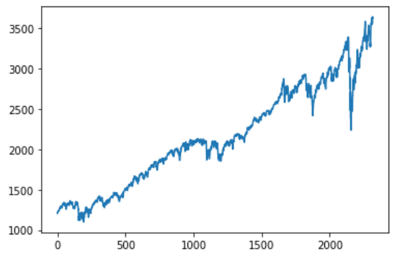
The Initial Dataset
Pulled from Yahoo Finance
10 years of stock data
Multiple sources
Value of S&P 500 at Close, 12/01/10 - 12/01/20
Notes:
So for this project, we pulled data from yahoo finance which listed daily values pertaining to different stock market indexes. These include opening values, closing values, daily highs and lows, as well as volume of stocks traded. Though we are predicting the S&P 500, we also pulled data for other indexes of the US market, as well as a few international indexes. The reason for this is that these markets - especially now as the world becomes an increasingly global society - are intertwined and often indicative of each other. As such, it is important to look at these other markets even when predicting for a US based index.

Slide 8
Dataset Features
Open
High
Low
SP_Close
Volume
FTSE_Close
NIKKEI_Close
DJI_Close
NASDAQ_Close
CAC_Close

Slide 9
Tests performed on the given dataset:
Shapiro-Wilk Test
Chi-Squared Test
P-Test
Kolmogorov Smirnov Test

Slide 10
Data Analysis & Preprocessing
Ensured null values were removed
Renamed columns as necessary
Graphed data
Summarized data
Added new & relevant data fields based on columns from dataset

Slide 11
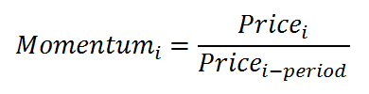
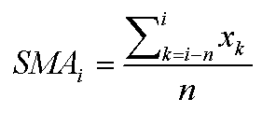

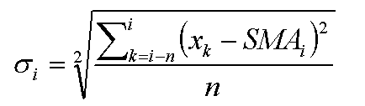
Formulas for Added Fields

Slide 12
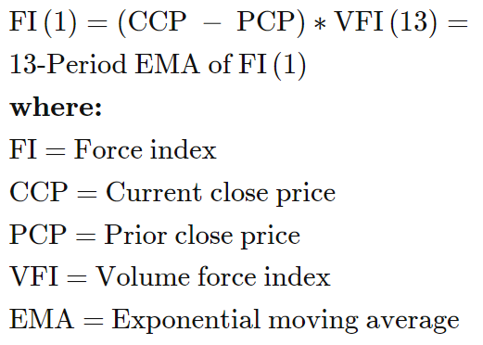
Formulas (cont.)

Slide 13
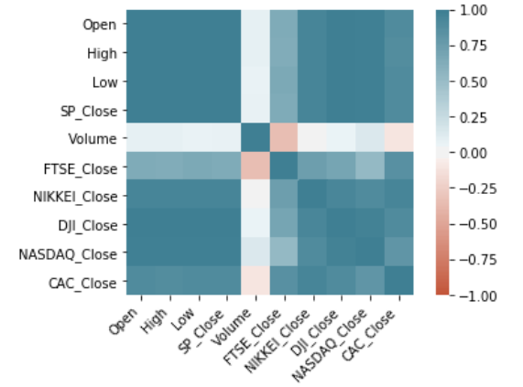
HEATMAP for the new dataset

Slide 14
Machine Learning Algorithms Used
Logistic Regression
Decision Tree Classifier
Support Vector Classification
Gaussian Naive Bayes
Random Forest Classifier

Slide 15
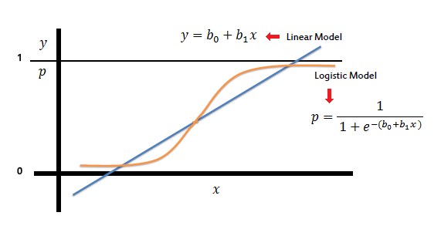
Logistic Regression
Basic and popular algorithm used for classification
Good for classification problems with only two outcomes

Slide 16
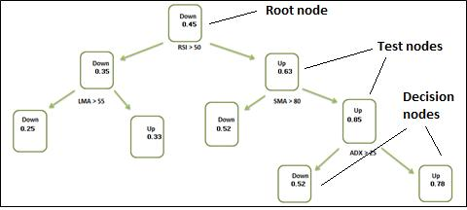
Decision Tree Classifier
Learned about in class
Dataset has many technical indicators through which to split the tree
Lays out all paths to outcomes
Example of decision tree being used to predict stock movement

Slide 17
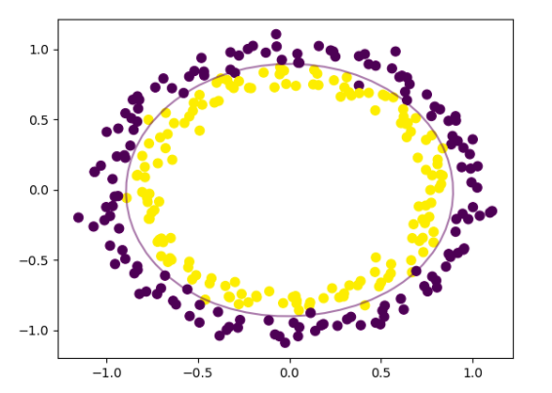
Support Vector Classification
SVC is good at locating global minimum
Good fit to classify non-linear patterns

Slide 18
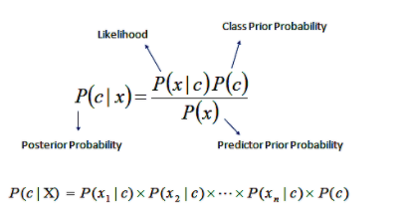
Gaussian Naive Bayes or Probabilistic Classifier
Computationally fast
Strong feature independence assumption

Slide 19
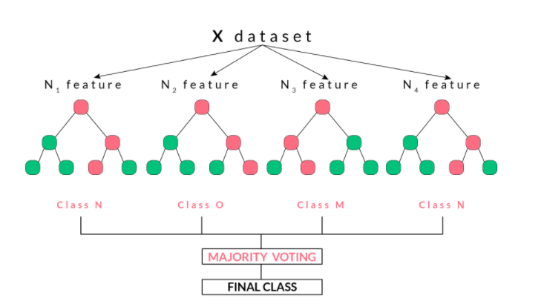
Random Forest Classifier
Works on the basis of ensemble learning technique
Best in prediction rate compared to that of Decision tree classifier

Slide 20
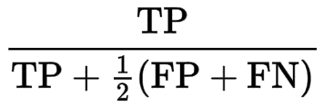

Note: Results in this table show best-case accuracy
Classifier Results
Classifier | F1 Score | Accuracy Score | AUC Score
Decision Tree Classifier | 0.7040 | 0.6300 | 0.6060
Gaussian Naive Bayes | 0.7164 | 0.6200 | 0.5701
Support Vector Classification | 0.7730 | 0.6300 | 0.5000
Random Forest Classifier | 0.7259 | 0.6300 | 0.6010
Logistic Regression | 0.7451 | 0.6100 | 0.5064

Slide 21
Conclusion
Best Model: Random Forest
Best F1 Score (0.7259); Tied for best Accuracy Score (0.6300)
Second Best: Decision Tree
Tied for best Accuracy Score; Decent F1 and AUC Scores
SVC is tied for best Accuracy Score, but AUC is 0.5000
This suggests that model is unable to discriminate well

Slide 22
Areas of Improvement
Try out different machine learning algorithms
Tweak more hyperparameters
Train the model with sophisticated deep learning algorithms

Slide 23
References:
Adebiyi, A. A., Adewumi, A. O., & Ayo, C. K. (2014). Comparison of ARIMA and Artificial Neural Networks Models for Stock Price Prediction. Journal of Applied Mathematics, 2014, 1–7. https://doi.org/10.1155/2014/614342
Adya, M. and Collopy, F. (1998), How effective are neural networks at forecasting and prediction? A review and evaluation. J. Forecast., 17: 481-495. https://doi.org/10.1002/(SICI)1099-131X(1998090)17:5/6<481::AID-FOR709>3.0.CO;2-Q
Weng, B. (2017). Application of machine learning techniques for stock market prediction.

Slide 24

Thank You

